Slide 1
Review Session 5
API-201, 10.15.21
Sophie Hill

Slide 2
Agenda
Review midterm Q2 sensitivity analysis
Sampling distributions
Build a hypothesis test worksheet in Excel!

Slide 3
Midterm Q2

Slide 4
Midterm Q2
Calculate the range of vaccination rates that would indicate that getting the vaccine is effective at preventing the spread of COVID.
We originally assumed that the vaccination rate was 95%. Now we are going to let that vary, so let’s call it X.
What does it mean for the vaccine to be effective? It means your risk of infection should be lower if you have the vaccine than if you don’t.
i.e. , P(COVID | vax) < P(COVID | unvax)
Let’s set this to be equal to find the threshold, and then check whether the range will be above or below that threshold.

Slide 5
Midterm Q2
Calculate the range of vaccination rates that would indicate that getting the vaccine is effective at preventing the spread of COVID.
We originally assumed that the vaccination rate was 95%. Now we are going to let that vary, so let’s call it X.
What does it mean for the vaccine to be effective? It means your risk of infection should be lower if you have the vaccine than if you don’t.
i.e. , P(COVID | vax) < P(COVID | unvax)
Let’s set this to be equal to find the threshold, and then check whether the range will be above or below that threshold.

Slide 6
Midterm Q2
Calculate the range of vaccination rates that would indicate that getting the vaccine is effective at preventing the spread of COVID.
We originally assumed that the vaccination rate was 95%. Now we are going to let that vary, so let’s call it X.
What does it mean for the vaccine to be effective? It means your risk of infection should be lower if you have the vaccine than if you don’t.
i.e. , P(COVID | vax) < P(COVID | unvax)
Let’s set this to be equal to find the threshold, and then check whether the range will be above or below that threshold.

Slide 7
Midterm Q2
Calculate the range of vaccination rates that would indicate that getting the vaccine is effective at preventing the spread of COVID.
We originally assumed that the vaccination rate was 95%. Now we are going to let that vary, so let’s call it X.
What does it mean for the vaccine to be effective? It means your risk of infection should be lower if you have the vaccine than if you don’t.
i.e. , P(COVID | vax) < P(COVID | unvax)
Let’s set this to be equal to find the threshold, and then check whether the range will be above or below that threshold.

Slide 8
Midterm Q2
Calculate the range of vaccination rates that would indicate that getting the vaccine is effective at preventing the spread of COVID.
We originally assumed that the vaccination rate was 95%. Now we are going to let that vary, so let’s call it X.
What does it mean for the vaccine to be effective? It means your risk of infection should be lower if you have the vaccine than if you don’t.
i.e. , P(COVID | vax) < P(COVID | unvax)
Let’s set this to be equal to find the threshold, and then check whether the range will be above or below that threshold.

Slide 9
Midterm Q2
Calculate the range of vaccination rates that would indicate that getting the vaccine is effective at preventing the spread of COVID.
We originally assumed that the vaccination rate was 95%. Now we are going to let that vary, so let’s call it X.
What does it mean for the vaccine to be effective? It means your risk of infection should be lower if you have the vaccine than if you don’t.
i.e. , P(COVID | vax) = P(COVID | unvax)
Let’s set this to be equal to find the threshold, and then check whether the range will be above or below that threshold.

Slide 10
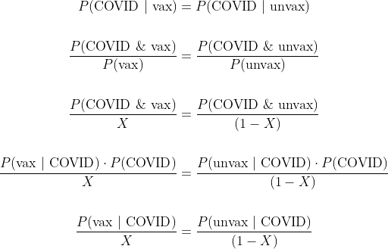
Midterm Q2

Slide 11
Midterm Q2

Slide 12
Midterm Q2

Slide 13
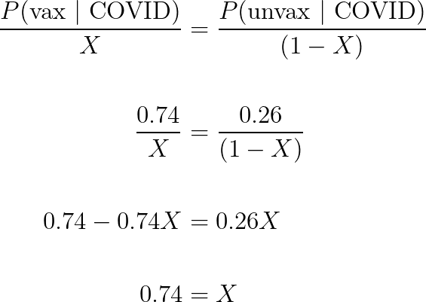
Midterm Q2

Slide 14
Midterm Q2
We ended up with a value, 74%, that is the same as P(vax | COVID). How come?
If the vaccine is effective, then the vaccinated should be a smaller proportion of the infected than the population… i.e., the vaccinated should be a larger proportion of the population than the infected.
So the vaccine is effective if the vaccination rate in the population is above 74% (and has no effect when it is equal to 74%).

Slide 15
Midterm Q2
We ended up with a value, 74%, that is the same as P(vax | COVID). How come?
If the vaccine is effective, then the vaccinated should be a smaller proportion of the infected than the population… i.e., the vaccinated should be a larger proportion of the population than the infected.
So the vaccine is effective if the vaccination rate in the population is above 74% (and has no effect when it is equal to 74%).

Slide 16
Midterm Q2
We ended up with a value, 74%, that is the same as P(vax | COVID). How come?
If the vaccine is effective, then the vaccinated should be a smaller proportion of the infected than the population… i.e., the vaccinated should be a larger proportion of the population than the infected.
So the vaccine is effective if the vaccination rate in the population is above 74% (and has no effect when it is equal to 74%).

Slide 17
Sampling distribution

Slide 18
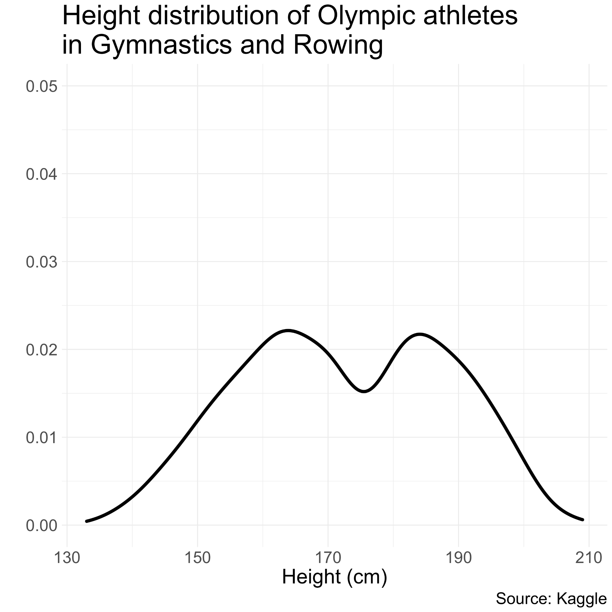
Distribution of height
of Olympic athletes

Slide 19
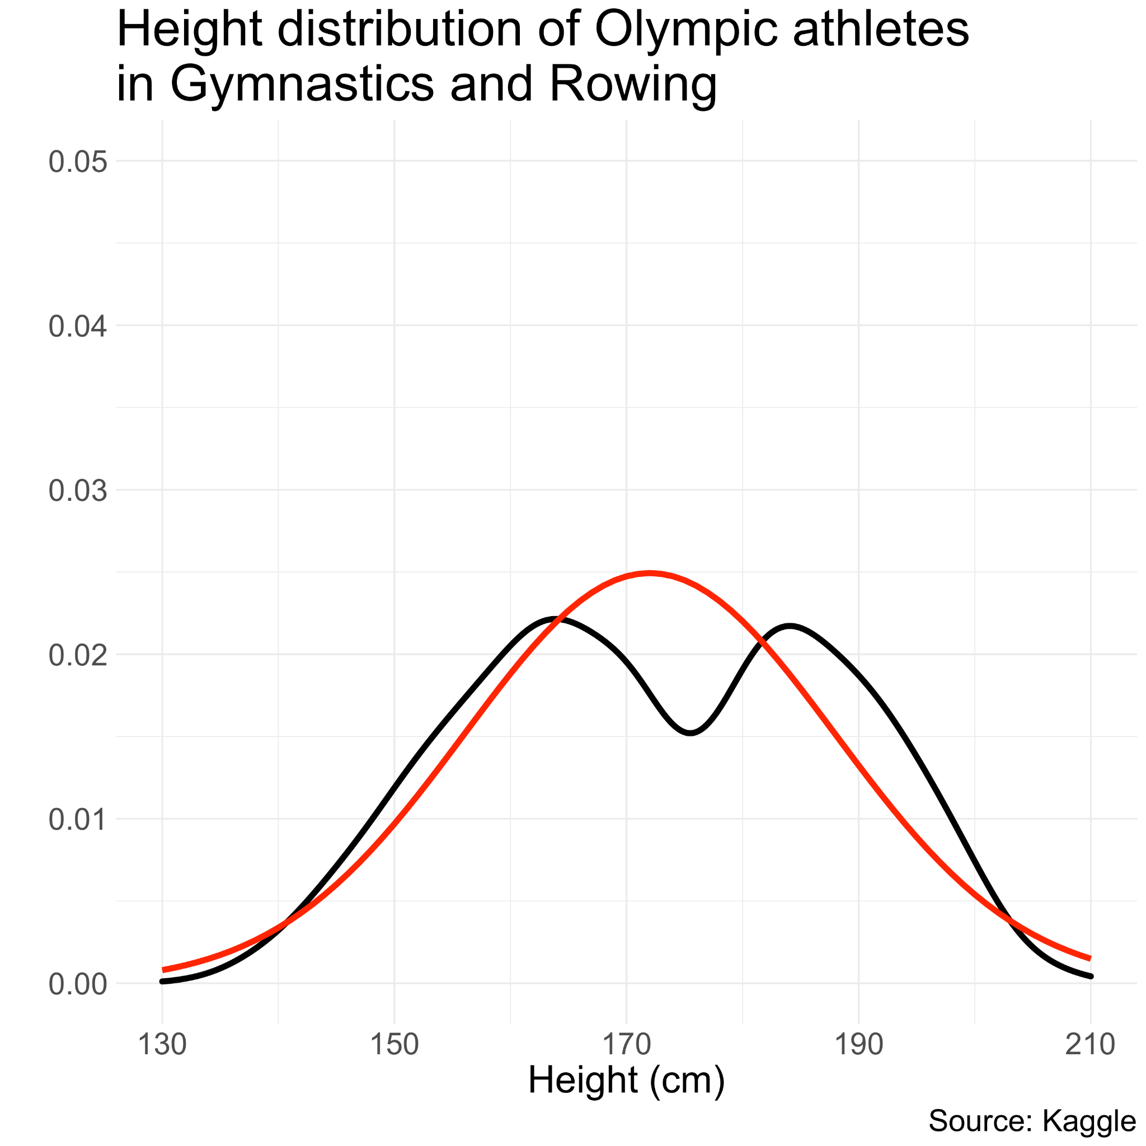
Distribution of height
of Olympic athletes
Not normally distributed!
Why?

Slide 20
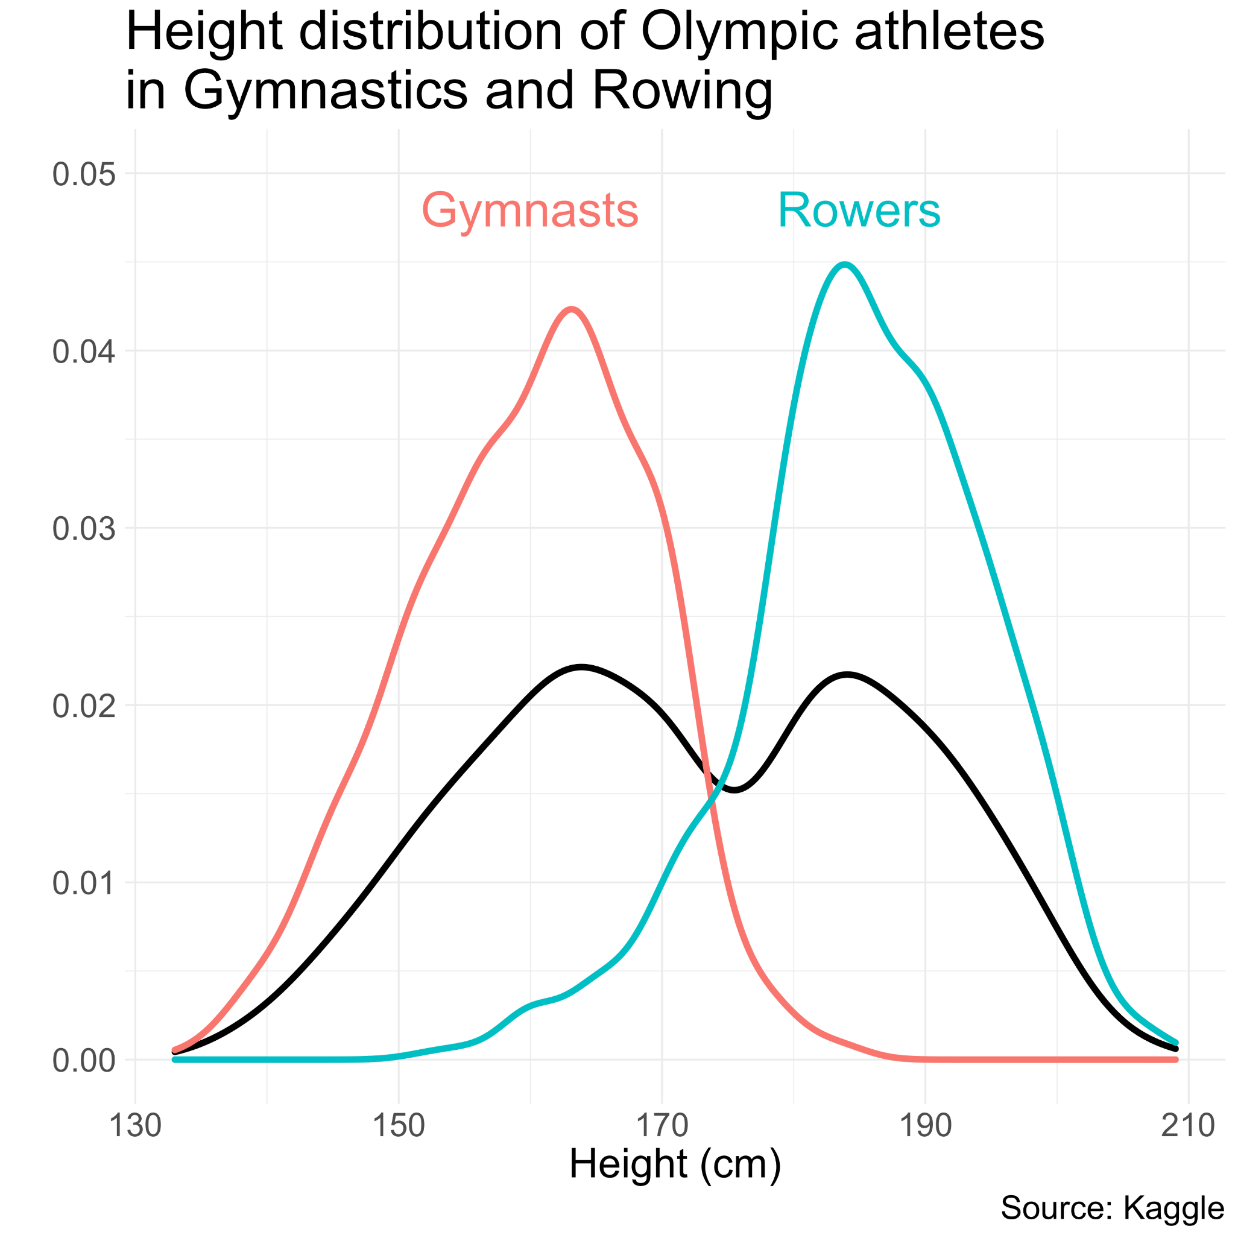
Distribution of height
of Olympic athletes
Not normally distributed!
Gymnasts tend to be much shorter than Rowers...

Slide 21
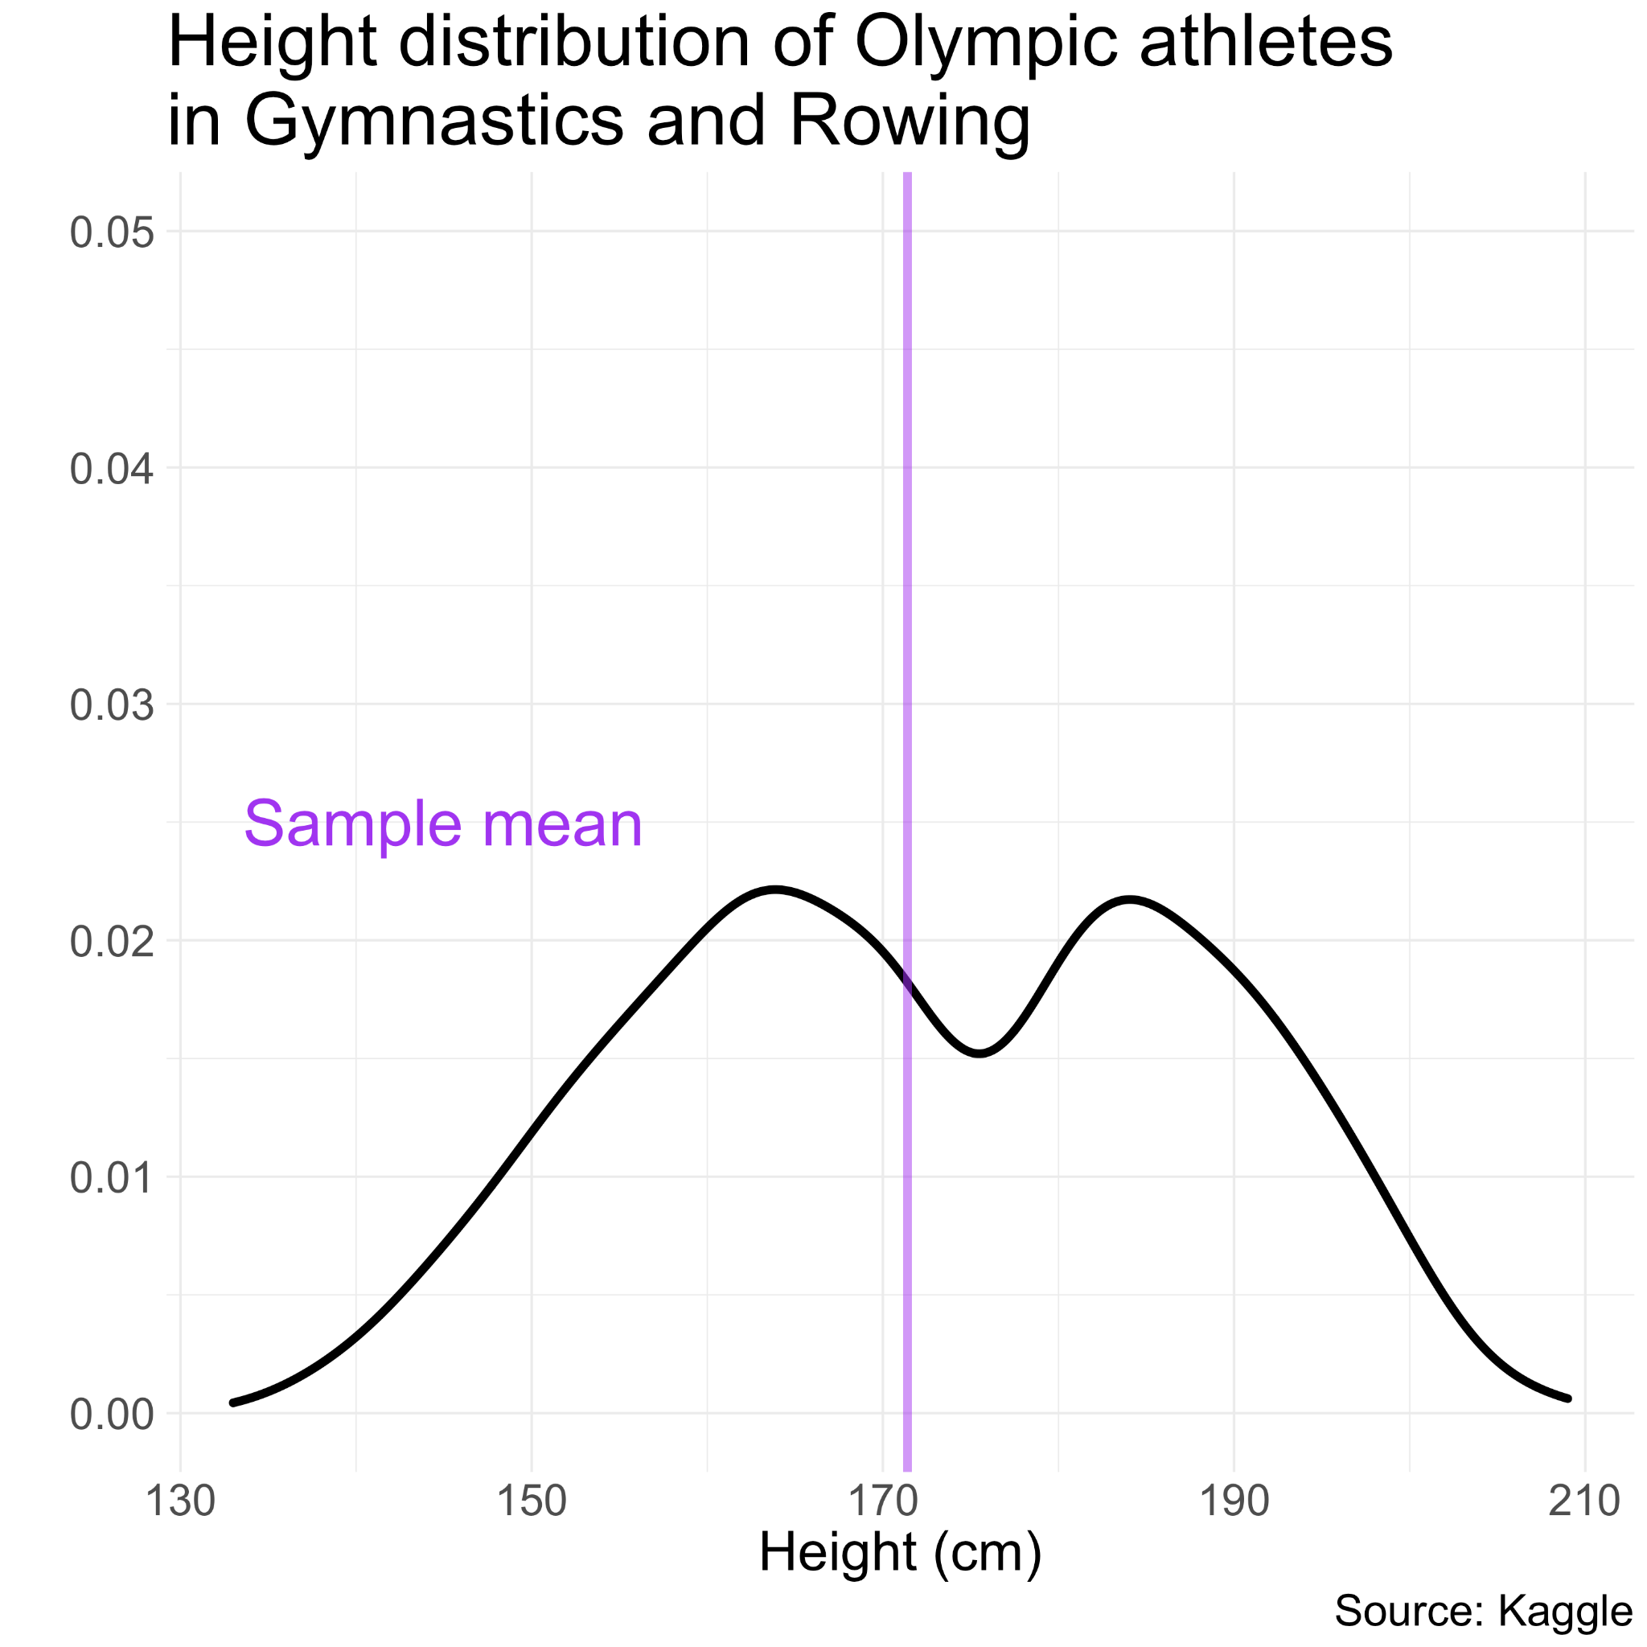
Distribution of height
of Olympic athletes
Now let’s take a random sample of 10 athletes and calculate the sample mean.

Slide 22
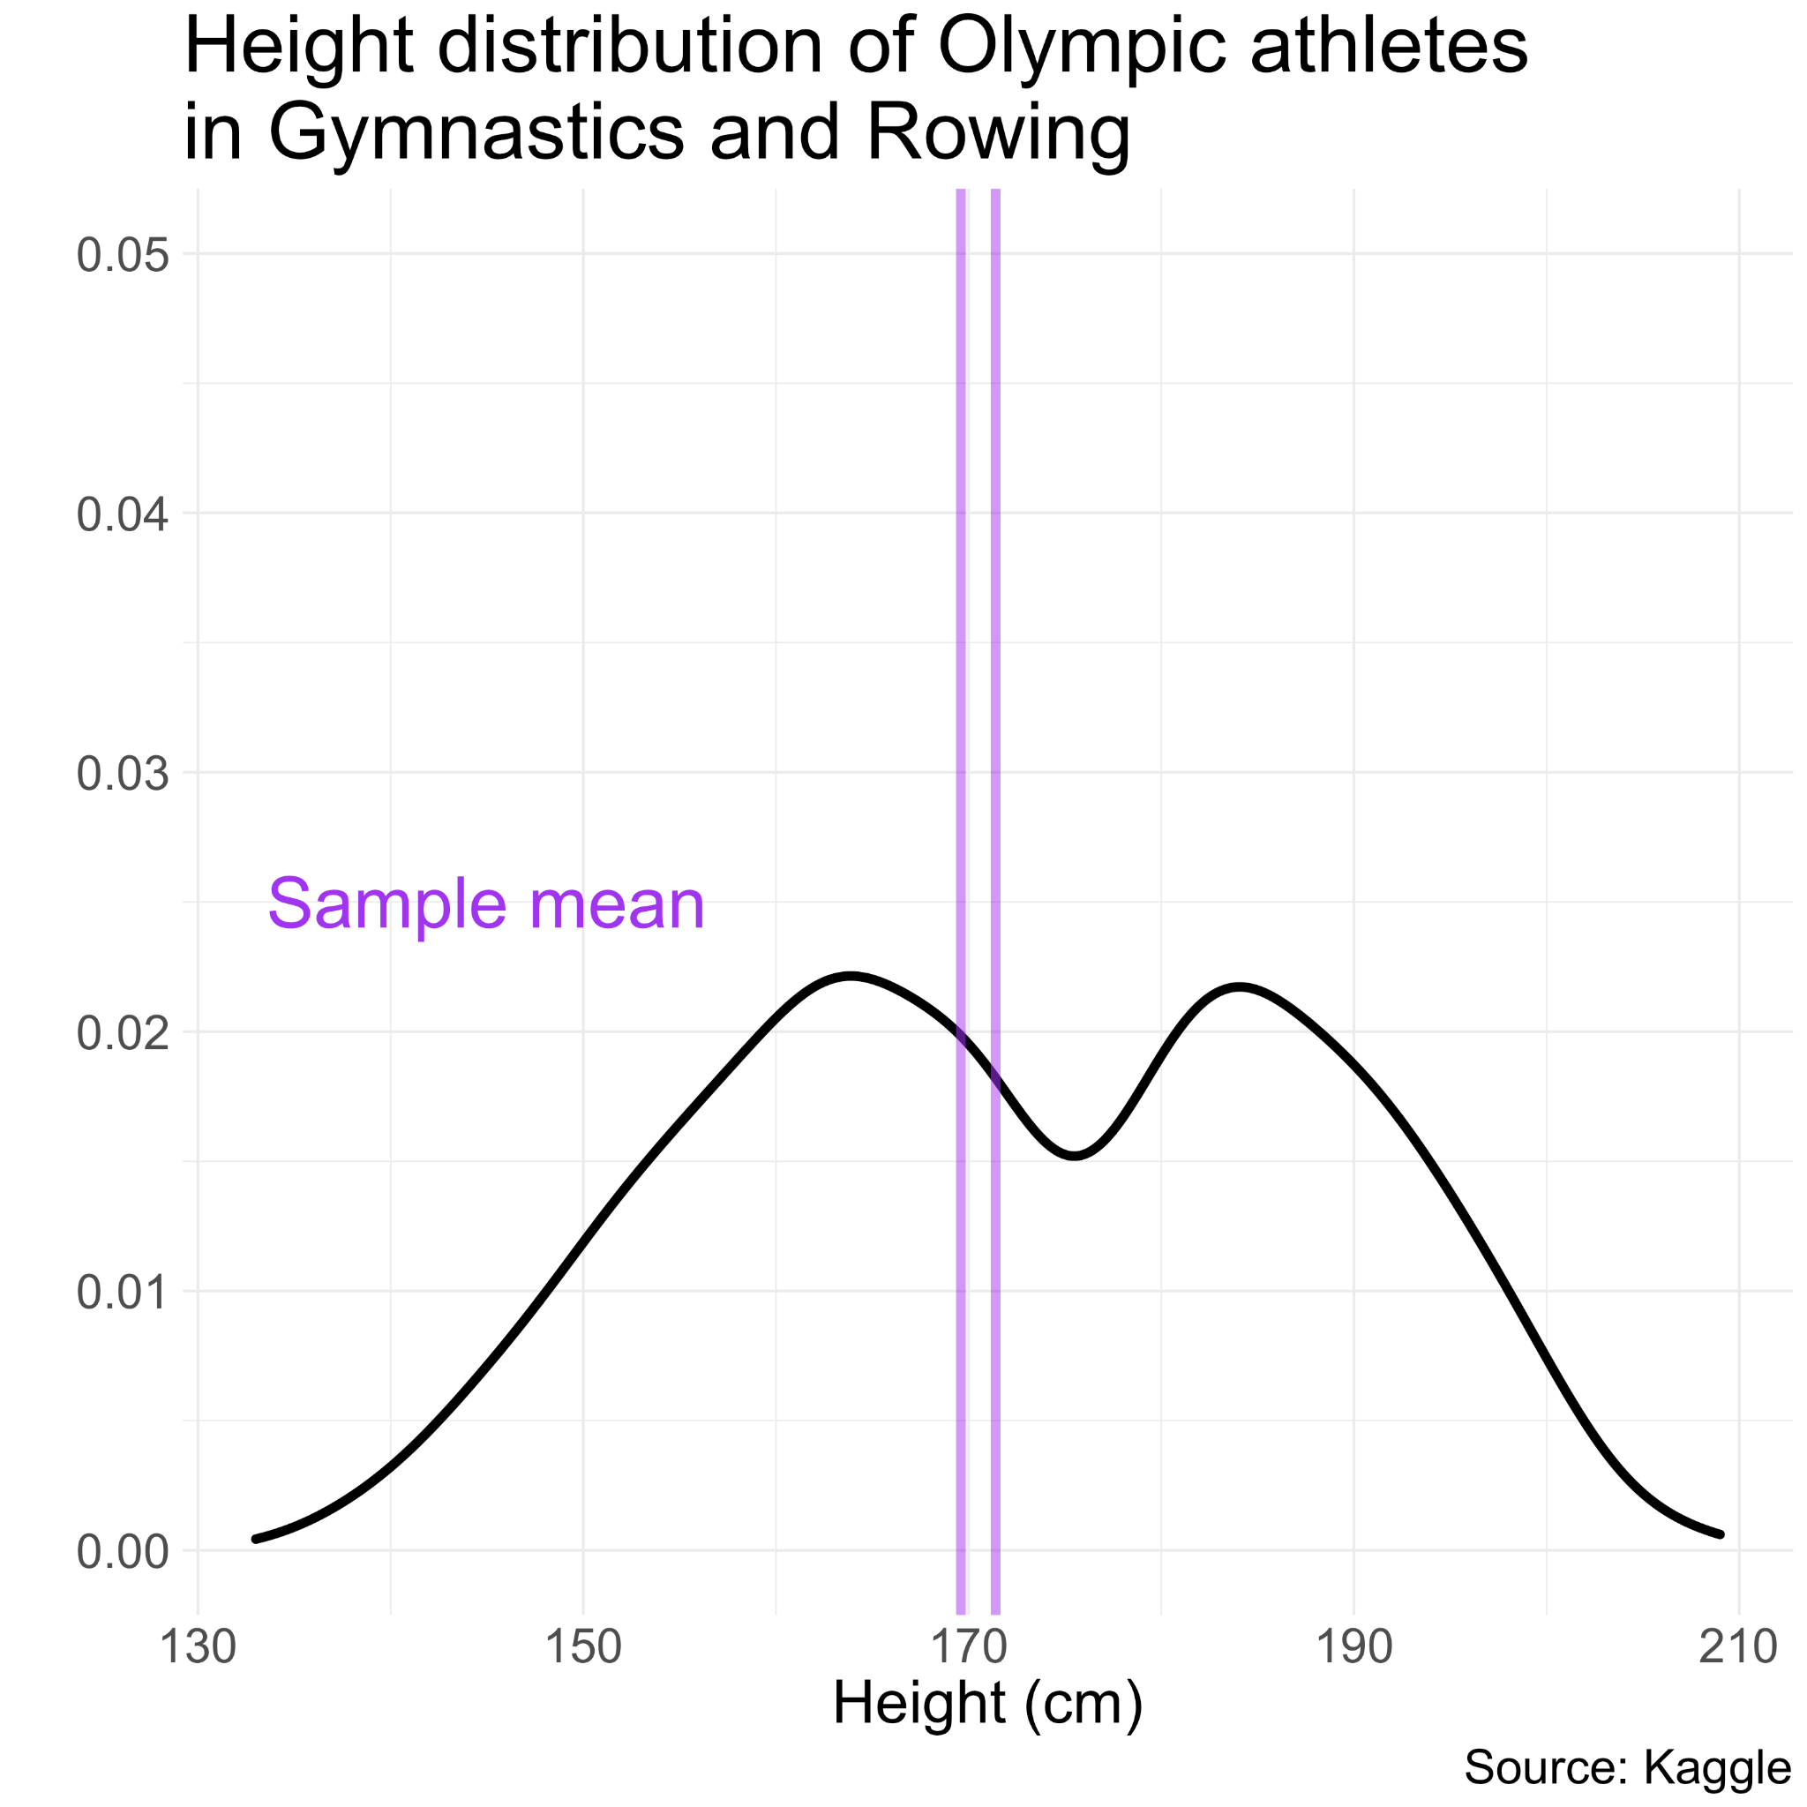
Distribution of height
of Olympic athletes
Now let’s take a random sample of 10 athletes and calculate the sample mean…
… and again.

Slide 23
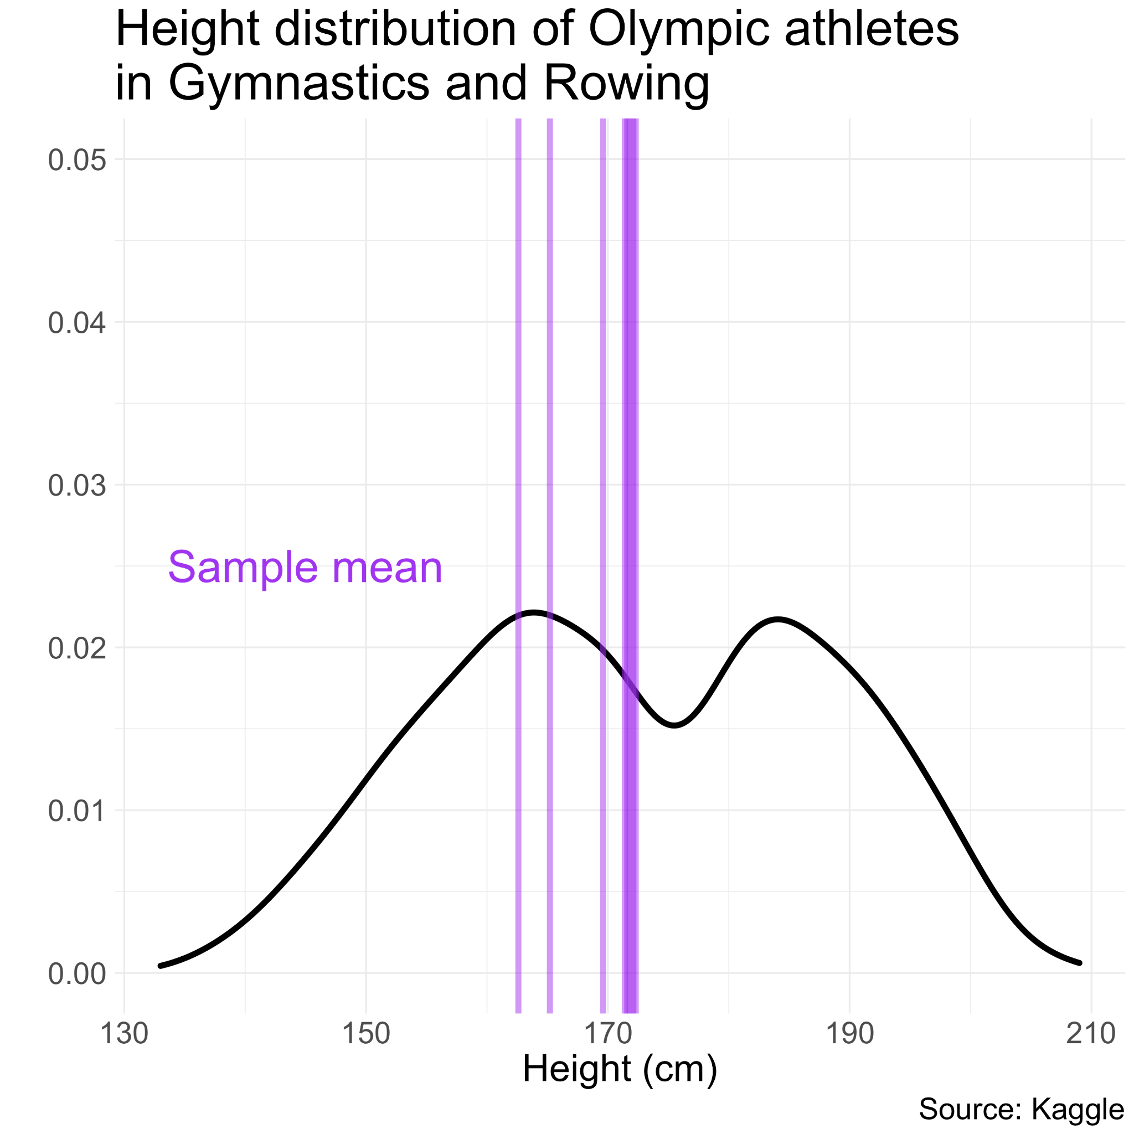
Distribution of height
of Olympic athletes
Now let’s take a random sample of 10 athletes and calculate the sample mean…
… and again.

Slide 24
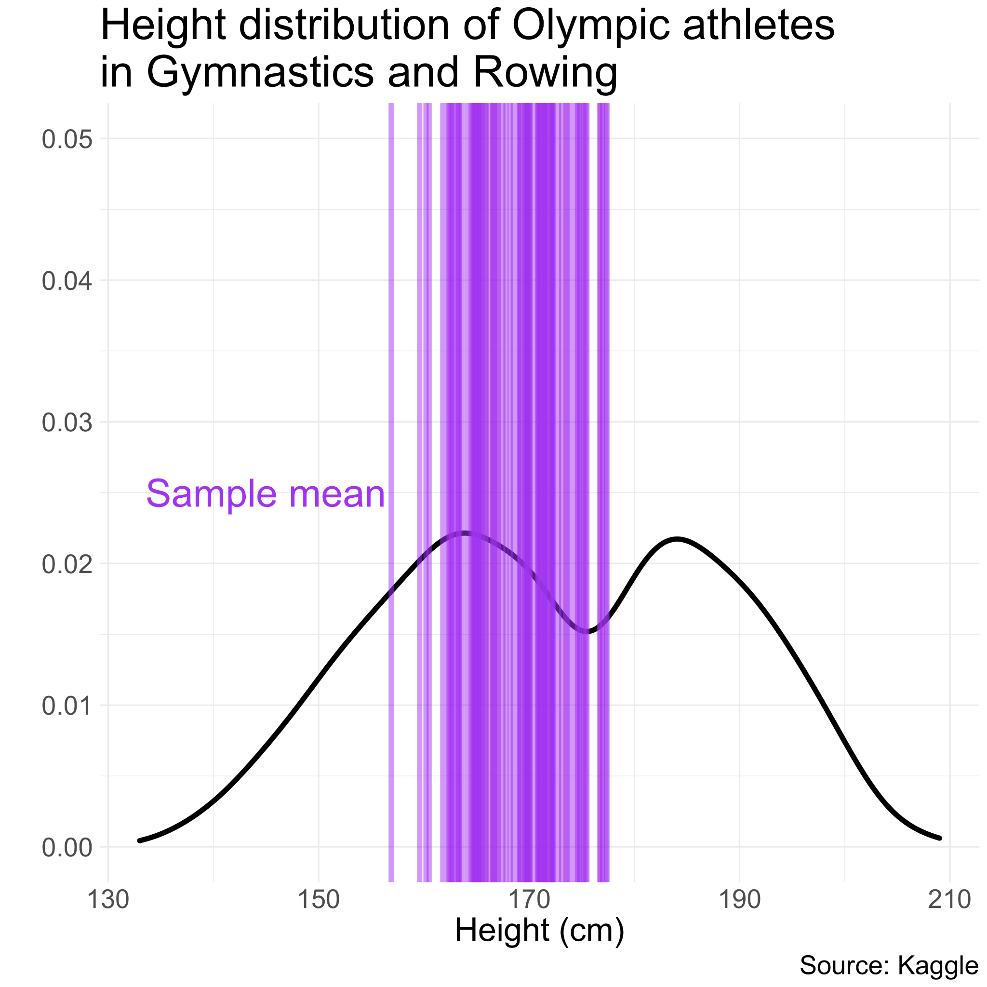
Distribution of height
of Olympic athletes
Now let’s take a random sample of 10 athletes and calculate the sample mean…
… and again.

Slide 25
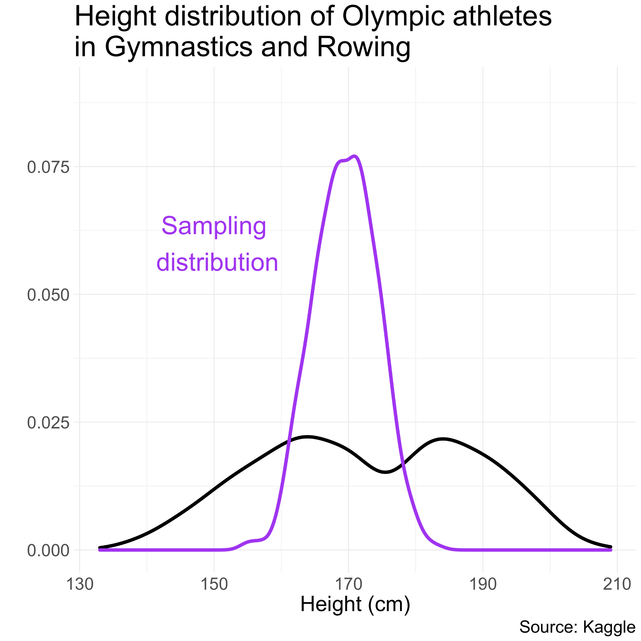
Distribution of height
of Olympic athletes
If we did this lots of times, we could plot the PDF of the sample means, i.e., the sampling distribution.
What do you notice about its shape, compared to the PDF of the raw data?

Slide 26
Distribution of height
of Olympic athletes
Key takeaway:
The sampling distribution is approximately normal, even though the raw distribution is not.
This is the magic of the CLT!!

Slide 27
Hypothesis tests

Slide 28
Hypothesis tests
Conducting a hypothesis test for a sample proportion is actually pretty straightforward: once you’ve done one, you’ve done them all!

Slide 29
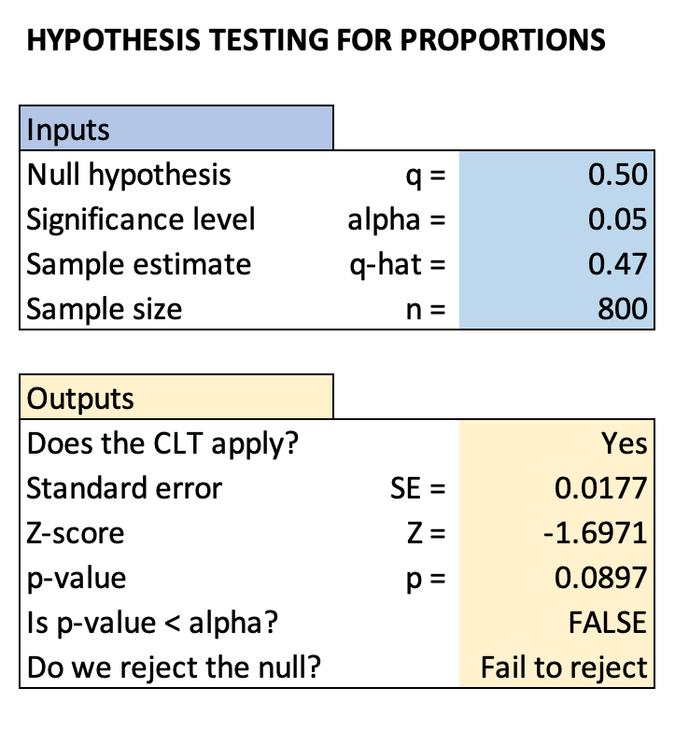
Hypothesis tests
Conducting a hypothesis test for a sample proportion is actually pretty straightforward: once you’ve done one, you’ve done them all!
Let’s make a hypothesis test worksheet in Excel (link to template on Canvas).

Slide 30
FAQs

Slide 31
Why does the formula for the p-value look like that??
We told you that you can calculate a p-value from a Z-score in Excel using this formula:
= 2 ∗ (1 − 𝑁𝑂𝑅𝑀.𝑆.𝐷𝐼𝑆𝑇(𝐴𝐵𝑆(𝑍),𝑇𝑅𝑈𝐸))

Slide 32
Why does the formula for the p-value look like that??
We told you that you can calculate a p-value from a Z-score in Excel using this formula:
= 2 ∗ (1 − 𝑁𝑂𝑅𝑀.𝑆.𝐷𝐼𝑆𝑇(𝐴𝐵𝑆(𝑍),𝑇𝑅𝑈𝐸))
But what does it actually mean??

Slide 33
Why does the formula for the p-value look like that??
We told you that you can calculate a p-value from a Z-score in Excel using this formula:
= 2 ∗ (1 − 𝑁𝑂𝑅𝑀.𝑆.𝐷𝐼𝑆𝑇(𝐴𝐵𝑆(𝑍),𝑇𝑅𝑈𝐸))
But what does it actually mean?? Let’s break it down step-by-step.

Slide 34
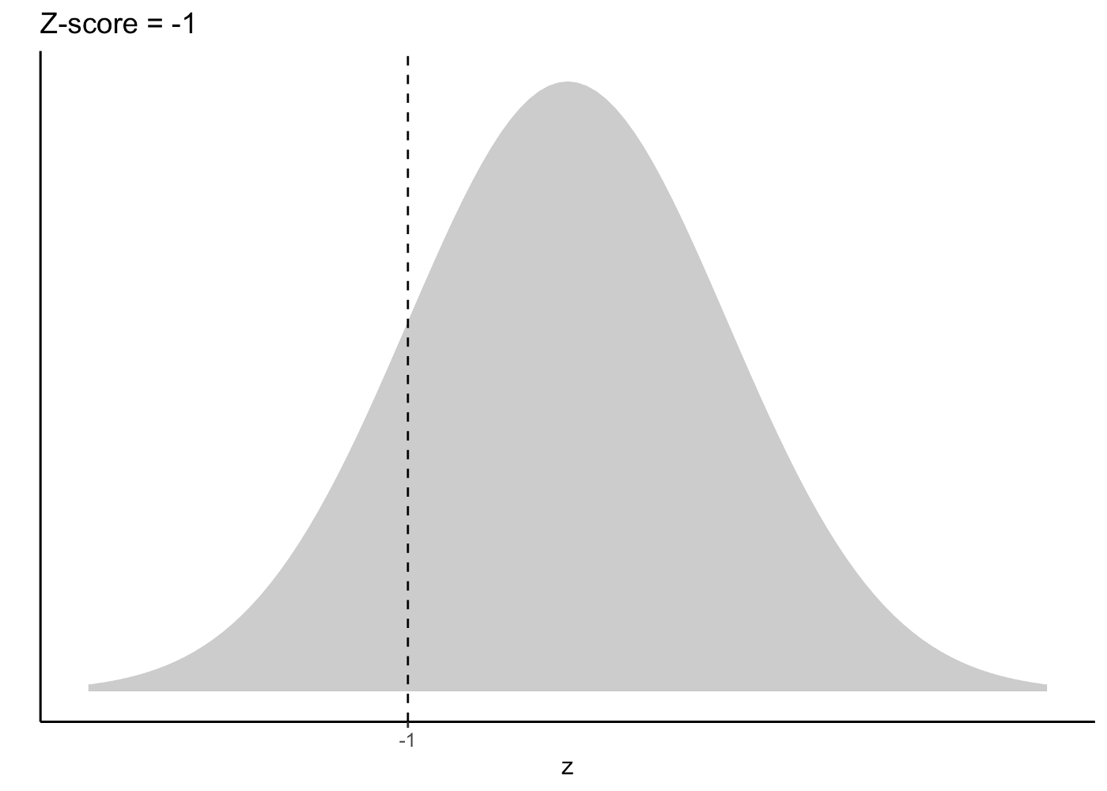
Why does the formula for the p-value look like that??

Slide 35
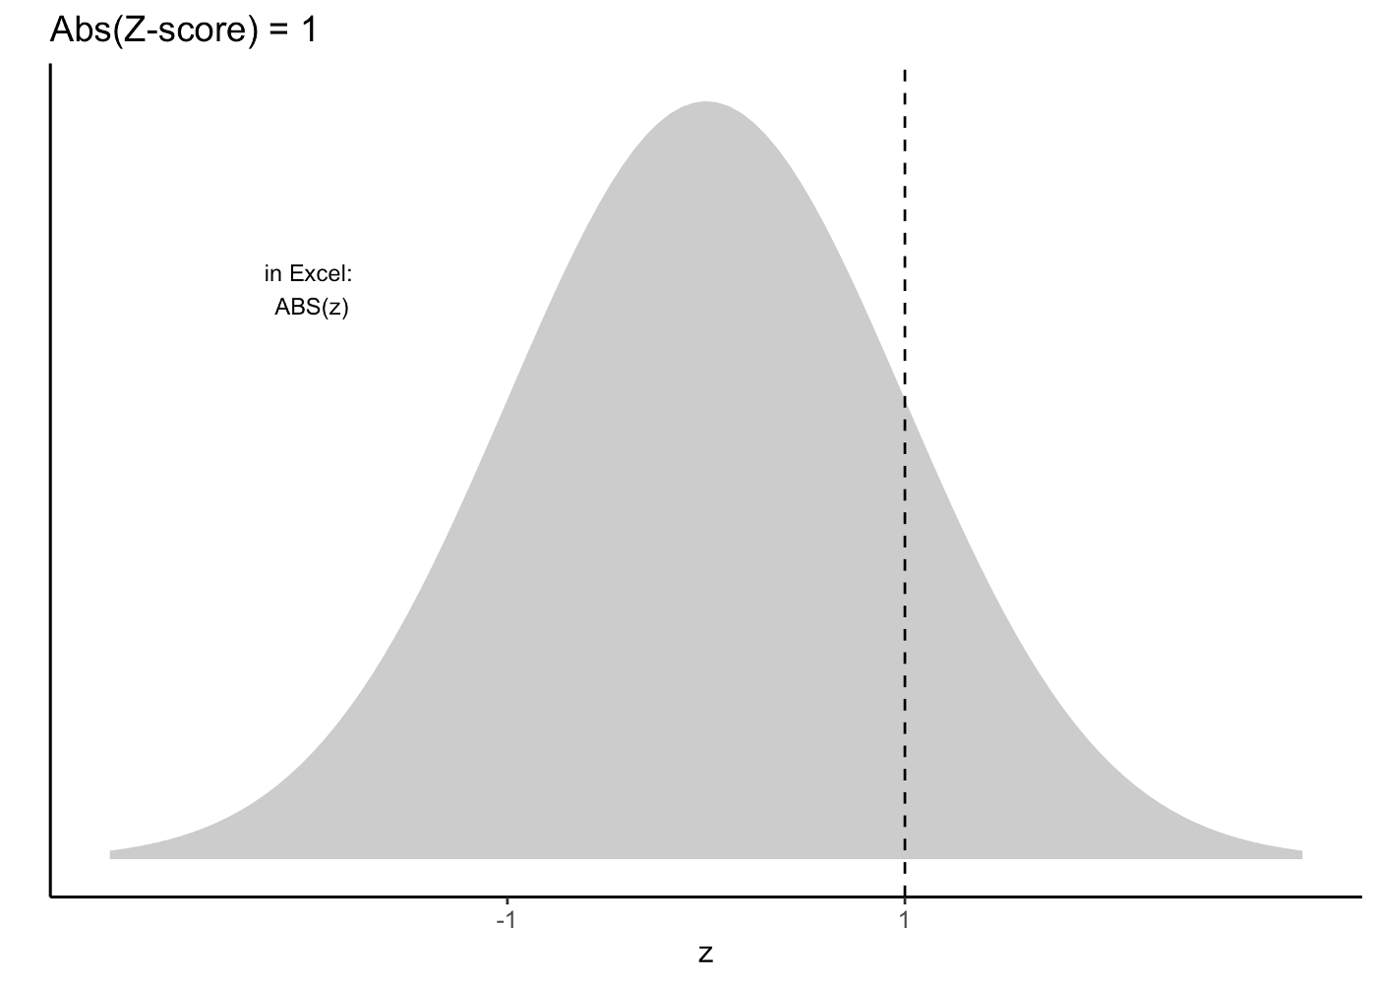
Why does the formula for the p-value look like that??

Slide 36
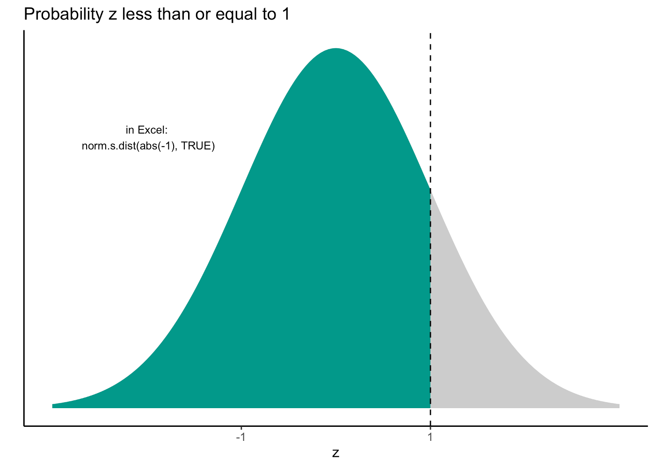
Why does the formula for the p-value look like that??

Slide 37
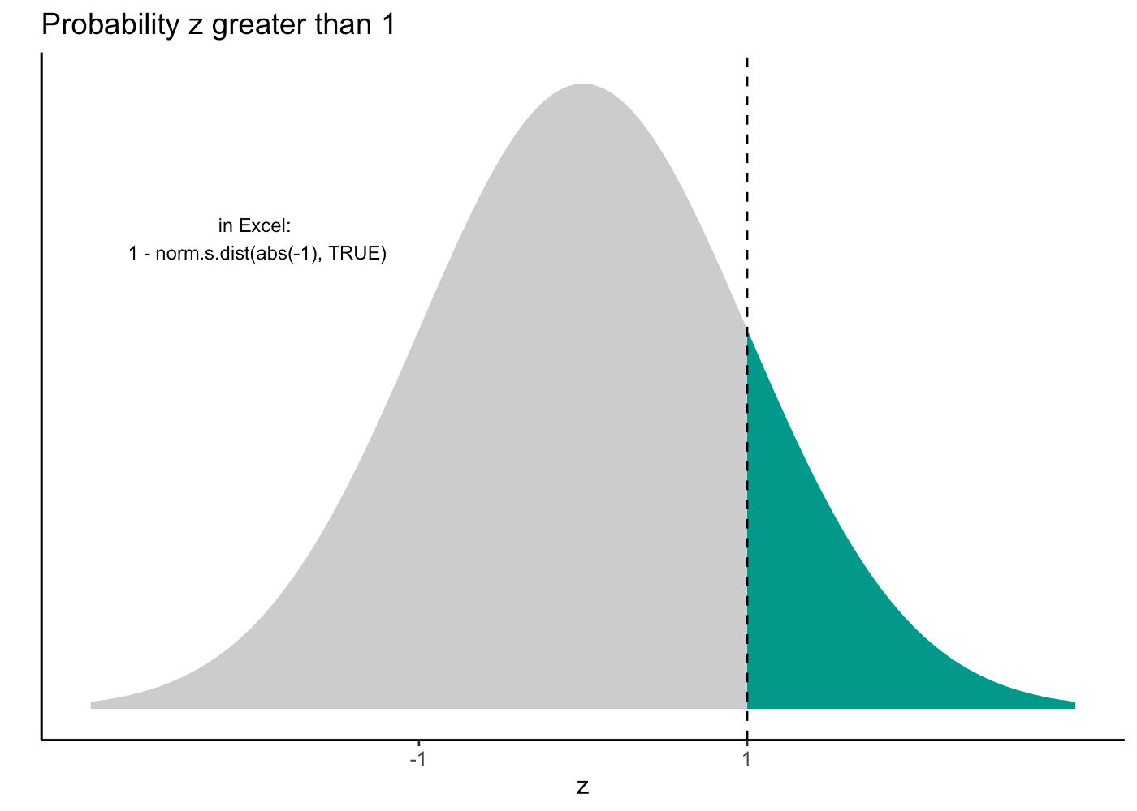
Why does the formula for the p-value look like that??

Slide 38
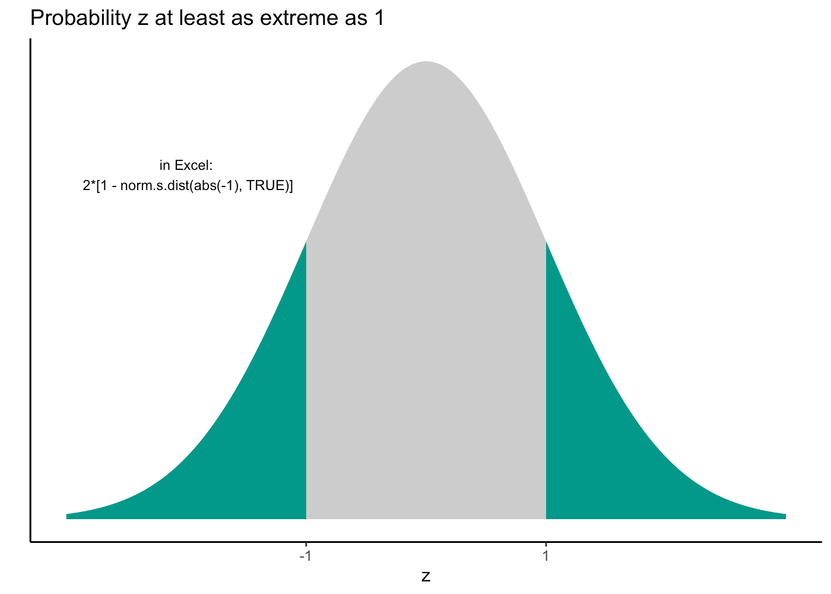
Why does the formula for the p-value look like that??

Slide 39
Why does the formula for the p-value look like that??
This is the p-value!!

Slide 40
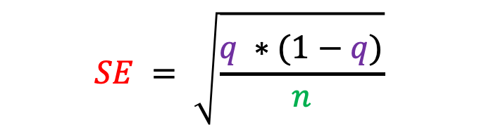
How does the proportion and sample size affect the SE?
What happens to SE as n increases (holding q fixed)?
What happens to SE as q increases (holding n fixed)?

Slide 41
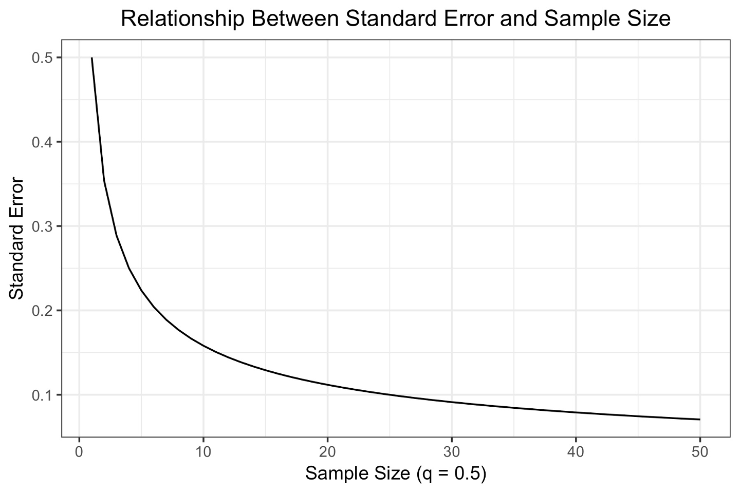
How does the proportion and sample size affect the SE?

Slide 42
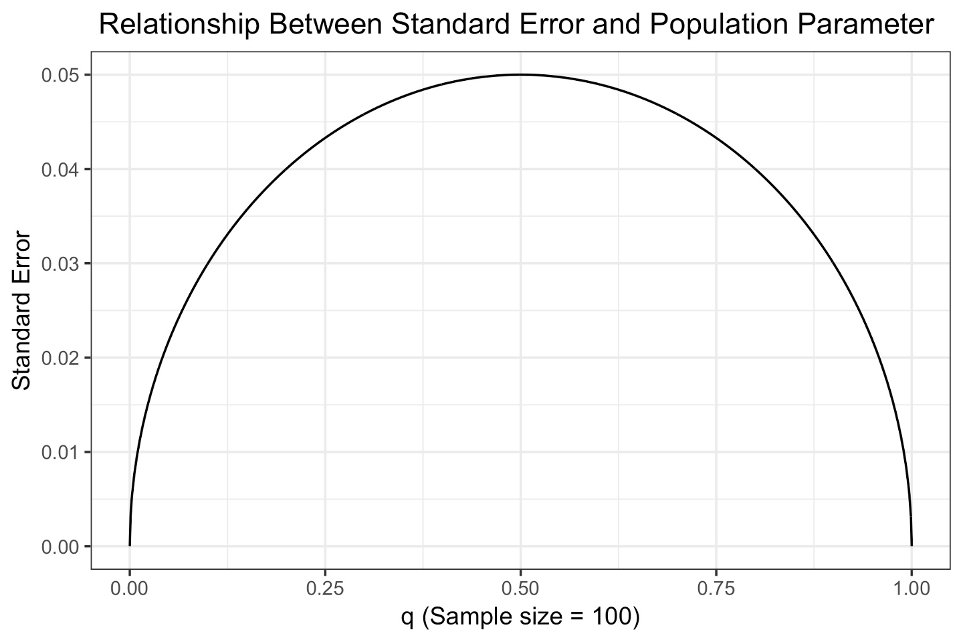
How does the proportion and sample size affect the SE?

